Slide 2
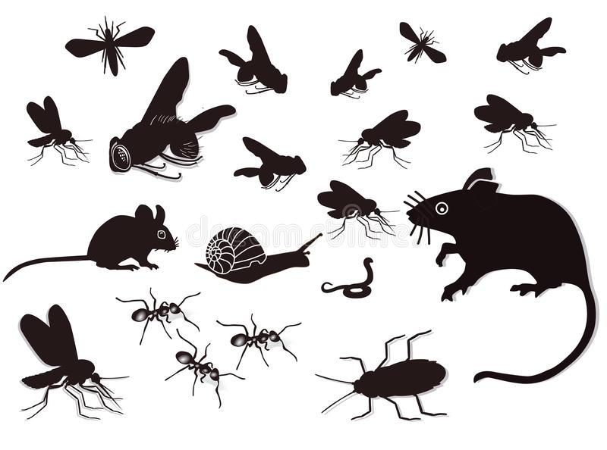
ULTRASONIC PEST AND RODENT REPELLER

Slide 3
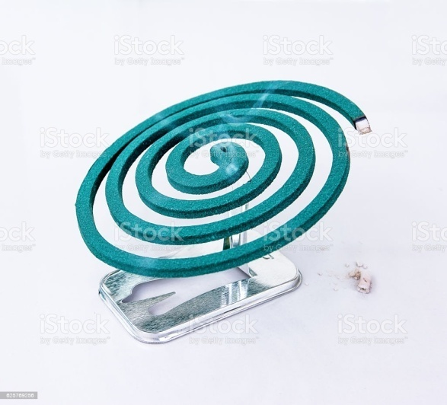
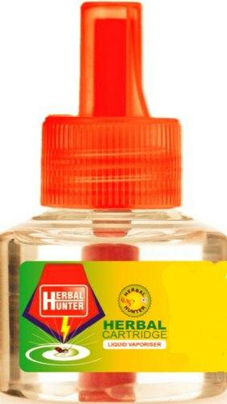
AN OUTLINE TO OUR PROJECT
Ultrasonic Pest Controllers Are Good Substitutes For Mosquito Coils , Chemical Pesticides , Liquid Vapourizers And So On.
It Is A Non Toxic Way To Repel Insects

Slide 4
HOW IT WORKS ?
As per scientific information and experimental evidences, the animals respond to US and avoid its presence. Small mammals like Dogs, Cats etc. responds to 22-25 kHz US and Rats to 60-72 kHz. Insects like Mosquitoes, Flies responds to 38-44 kHz.

Slide 5
WHAT IS ULTRASOUND?
The hearing property of human ear is limited. Human ear can perceive sound with in a frequency range of 20 Hz to 20 kHz.
The sound frequency below 20 Hz is Infrasonic sound and above 20 kHz is Ultrasonic sound. Human ear is not sensitive to US because the eardrum cannot vibrate as fast as US.
Ultrasound has high frequency, so the wave is very powerful. US travel along straight line even in the presence of obstacles. When the US hits an object, it bends and round and spread in all directions.

Slide 6
WHAT IS THE RELATION BETWEEN (US) ULTRASOUND AND ANIMALS?
Even though human ear cannot sense US, many animals can produce and hear US. Many insects, rodents, bats and small mammals communicate through US.
Insects have sensory structures to produce and detect ultrasound. Cockroaches have “Sensory hairs” to sense US. Spiders, Wasps, Beetles, Flies etc have a “Tympanic membrane” to detect US. Fleas communicate using high frequency US .

Slide 7
HOW DOES US AFFECT ANIMALS?
The US sensors are present in the antennae of Mosquitoes and genetalia of Cockroaches. US emitted by the Repeller will scare away the pests and confuse them.
Ultrasonic sound will create stress on the nervous system of insects and jam their own US frequency. This will immobilize the insects and they escape from the source of US.

Slide 8
HOW DOES ULTRASOUND REPEL PESTS?
US pest chasers are designed to repel pests from the home. Rodents respond to US with a frequency around 60 kHz. Cats and Dogs can be repelled using 22-25 kHz. Insects like mosquitoes, House fly, Fleas etc responds to 38-44 kHz. US will create high pressure on the eardrum of Rats so that they move away from US source. US generally creates stress on animals, so they avoid ultrasound.

Slide 9
DOESN’T IT AFFECT HUMANS?

Slide 10
IS IT SAFE FOR HUMAN BEINGS?
US Pest Repellers are widely used in Homes, Gardens, Farm yards etc. to repel various kinds of pests. Commercial US Pest Repellers are designed to emit US in the frequency range 20 kHz to 100 kHz.
US above 20 kHz is inaudible to man but children can hear the US to a certain level up to 30 kHz. Many house hold appliances like Telephone, Computer, Vacuum cleaner etc emit US, but we cannot hear it because it is inaudible.
US is considered as the safest method for scanning pregnancy. US scanning is widely used in hospitals. Echocardiogram also uses US to image the heart’s functions. As per the scientific information, US will not cause any health problems.

Slide 11
WHAT ARE THE IMPORTANT ASPECTS OF ULTRASOUND PEST CHASERS?
Most ultrasonic pest Repellers do not give better results due to one of the following reasons.
Power output of the Transducer. If the power output is low, pests will ignore the sound.
Direction and angle of sound. Usually ultrasound travels at an angle of 45 degree from the source. If there is an obstacle in the path, some of the sound waves will reflect and bend. This reduces the coverage area.
Response to animals. Usually small animals respond to US. These devices are used to repel pests from houses, farm yards, garden etc. The response depends on the number of pests in the population and the number of US waves reaching in their vicinity.
Some animals will ignore the US initially but later they avoid it. Some other animals, first show response and later learn to adjust with it.
Mosquito population is very large when compared to other animals. So the number of mosquitoes showing response is a matter of observation.

Slide 12

IS THERE ANY SAFETY RECOMMENDATI- ONS?
US is biologically safe to human beings as per scientific information. But US frequency close to 30 kHz can be sensed by children to a certain level. So it is recommended not to use such devices continuously near the children below 5 years.

Slide 13
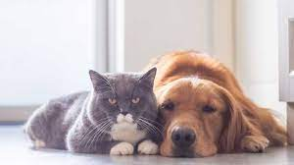
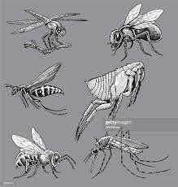
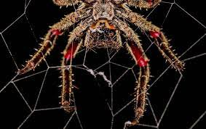
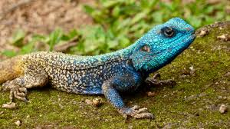
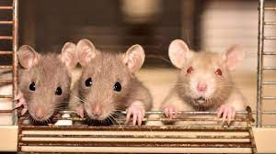
RESPONSE OF ANIMALS TO ULTRASOUND
22-25 kHz: Dogs, Cats
38-44 kHz: Mosquitoes, Fleas, House Fly, Spiders, Cockroaches
52-60 kHz: Lizards
60-72 kHz: Rats

